Slide 1
Use case 2 : HAPI FHIR Repository Server

Slide 2
Agenda
Deployment
Deployed FHIR Server details
Mappings
Boiler plate
Code Overview
Functionality Covered
Custom types, extensions
Observation mappings

Slide 3
Deploying FHIR JPA Server
Download the Server
https://github.com/hapifhir/hapi-fhir-jpaserver-starter
Running the Server
Accessing the Server
mvn jetty:run
http://localhost:8080/

Slide 4
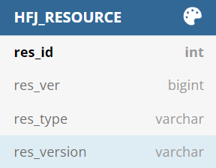
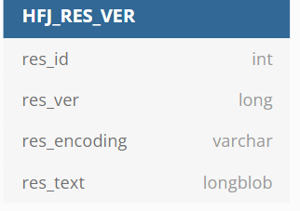
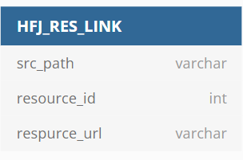
Database design (total 94 tables)

Slide 5
How to connect to FHIR server?
Open URL : https://fhir.coreseva.com/
Secured api url : https://api.coreseva.com

Slide 6
Capability statement & swagger
Documents set of capabilities (behaviors) of a FHIR Server
http://fhir.coreseva.com/fhir/metadata
Swagger:
http://fhir.coreseva.com/fhir/swagger-ui/

Slide 7
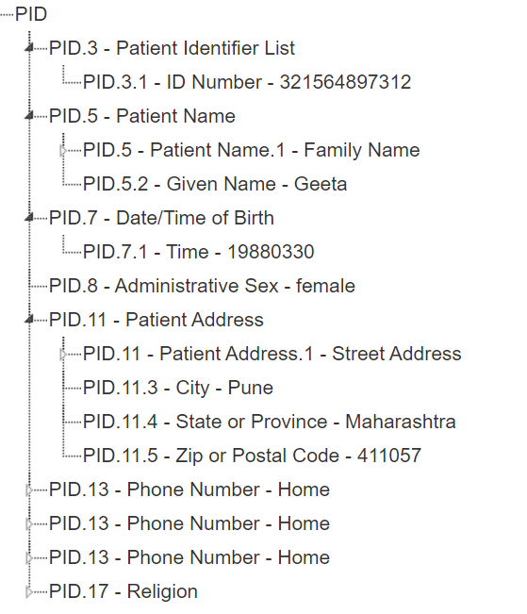
ADT_A01 mapping
https://www.nrces.in/ndhm/fhir/r4/StructureDefinition-Patient-mappings.html
MSH|^~\&|FHIRSystemApp||||20160627155652||ADT^A01^ADT_A01|f967b43d-7330-4355-ac13-85d60771b24d|P|2.6|||AL
EVN||20160627155652
PID|||321564897312||Shastri^Geeta||19880330|female|||Saarathi Signor^^Pune^Maharashtra^411057||^home^phone^^^^9898989877~^work^phone^^^^0231654476~^home^email^geeta_shastri@fhirconnectathon.com||||

Slide 8
Boiler plate code
Folder structure
Import into IDE
Setting for Log4j
Update the project and download dependencies
Starting Point
Sample message

Slide 9
Advance concepts
Extensions
Custom types

Slide 10
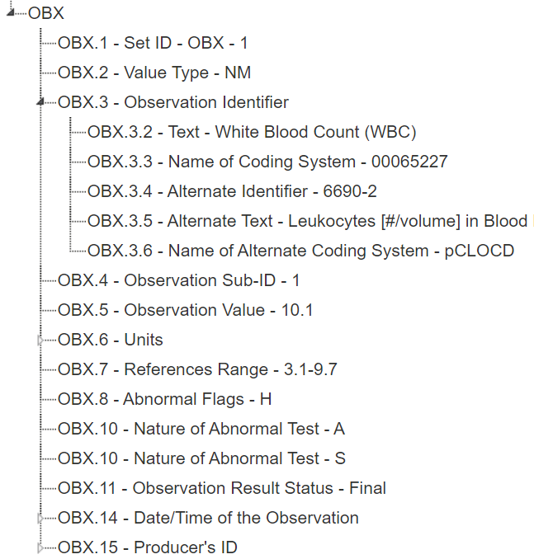
Observation mappings
https://www.nrces.in/ndhm/fhir/r4/StructureDefinition-Observation-mappings.html
MSH|^~\&|LAB|MYFAC|LAB||201411130917||ORU^R01^ORU_R01|3216598|D|2.6|||AL|NE|
PID|||321564897312||Shastri^Geeta||19880330|female|||Saarathi Signor^^Pune^Maharashtra^411057||^home^phone^^^^9898989877~^work^phone^^^^0231654476~^home^email^geeta_shastri@fhirconnectathon.com||||1020^Hinduism^http://terminology.hl7.org/CodeSystem/v3-ReligiousAffiliation
OBR|1|||^Complete Blood Count (CBC)^00065227^57021-8^CBC \T\ Auto Differential^pCLOCD|R||201411130914|||KYLA|original-order|||201411130914||^Xavarie^Sonna^^^^^XAVS||00065227||||201411130915||LAB|completed||^^^^^R|^Xavarie^Sonna^^^^^XAVS|
OBX|1|NM|^White Blood Count (WBC)^00065227^6690-2^Leukocytes [#/volume] in Blood by Automated count^pCLOCD|1|10.1|10\S\9/L|3.1-9.7|H||A~S|Final|||201411130916|MYFAC^MyFake Hospital^L|

Slide 11


